Slide 1
Modern Systems Analysis and Design Fifth Edition
Chapter 2: Planning
Identifying and Selecting Systems Development Projects
4.1

Slide 2
Learning Objectives
Describe the project identification and selection process
Describe the corporate strategic planning and information systems planning process
Explain the relationship between corporate strategic planning and information systems planning
4.2

Slide 3
Learning Objectives
Describe how information systems planning can be used to assist in identifying and selecting systems development projects
Analyze information systems planning matrices to determine affinity between information systems and IS projects and to forecast the impact of IS projects on business objectives
Describe the three classes of Internet electronic commerce applications:
Internet, Intranets and Extranets
4.3

Slide 4
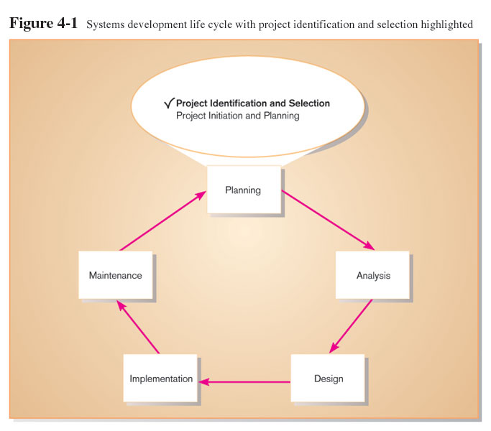
Identifying and Selecting Systems Development Projects

Slide 5
Identifying and Selecting IS Development Projects
Identifying potential development projects.
Identification from a stakeholder group.
Each stakeholder group brings their own perspective and motivation to the IS decision
The Process activities of identifying and selecting IS a
identifying potential IS development project,
classifying and Ranking IS development projects, and
selecting the IS development project.
Sources of projects (who?)
Management and business units
Managers who want to make a system more efficient or less costly
Formal planning groups
4.5

Slide 6
Identifying and Selecting IS Development Projects
Projects are identified by
Top management
Steering committee
User departments
Development group or senior IS staff
Bottom-up Identification
Business unit or IS group
Don’t reflect overall goals of the organization
Top-Down Identification
Senior management or steering committee
Focus is on global needs of organization
4.6

Slide 7
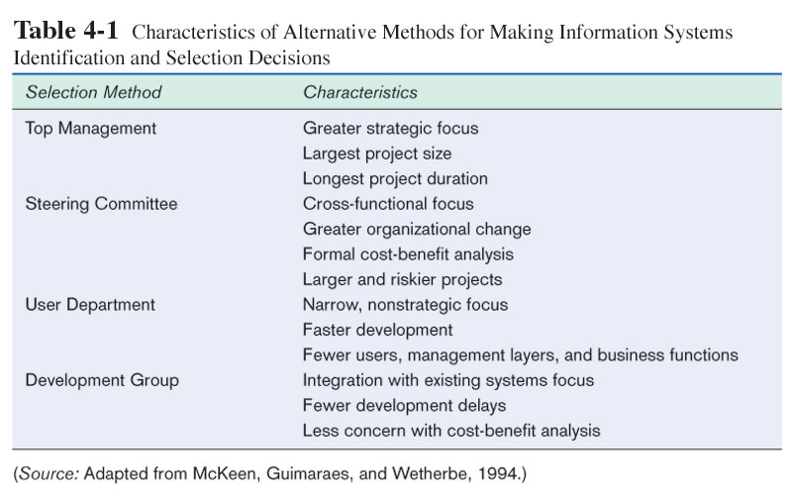
The Process of Identifying and Selecting IS Development Projects

Slide 8
Identifying and Selecting IS Development Projects
Classifying and Ranking IS Development Projects
Performed by top management, steering committee, business units of IS development group
Value chain analysis is often used
Method to analyze an organization’s activities to determine where value is added and costs are incurred
Some criteria should be considered when classifying and ranking projects are:
- Value chain analysis.
- Strategic alignment (how much the project help the organization in achieving its strategies).
- Potential benefits.
- Resource availability.
- Project size and duration.
- Technical difficulties and risks.
4.8

Slide 9
Identifying and Selecting IS Development Projects
Selecting IS Development Projects
Based on various factors.
Consider both short- and long-term projects.
Select those most likely to achieve business objectives.
Is a very important and ongoing activity.
Projects most likely to achieve business objectives are selected
Decision requires consideration of:
Perceived and real needs
Current organizational environment
Existing and available resources
Evaluation criteria
4.9

Slide 10
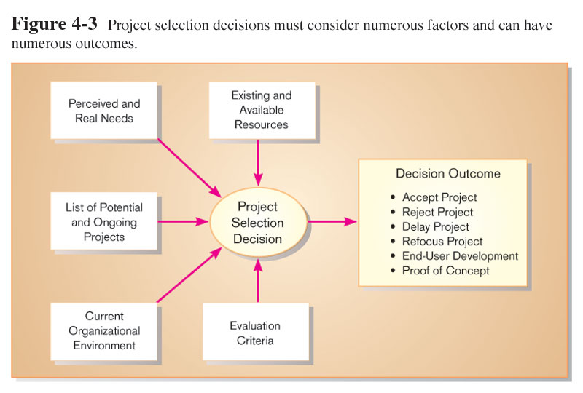
The Process of Identifying and Selecting IS Development Projects

Slide 11
Identifying and Selecting IS Development Projects
Selecting IS Development Projects decision outcomes:
Project Acceptance
Project Rejection
Delay
Refocus
End-User Development
Proof of Concept
4.11

Slide 12
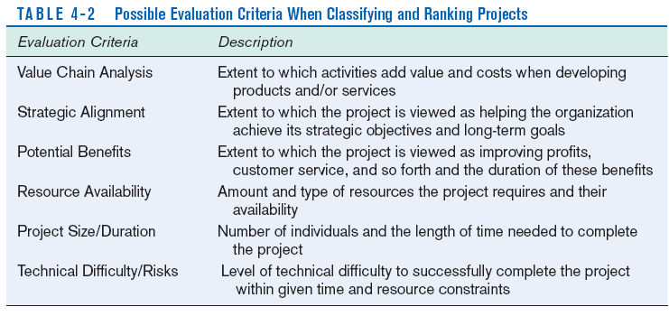
The Process of Identifying and Selecting IS Development Projects

Slide 13
Identifying and Selecting IS Development Projects
Incremental commitment, is a strategy in system analysis in which the project is reviewed after each phase and continuation of the project is re-justified.
Deliverables and Outcomes
Primary deliverable from the first part of the planning phase is a schedule of specific IS development projects.
Outcome of the next part of the planning phase – project initiation and planning – is the assurance that careful consideration was given to project selection and each project can help the organization reach its goals. Clear understanding of project’s relation to organizational objectives and the project role of achieving these objectives.
4.13

Slide 14
Identifying and Selecting IS Development Projects
Knowledge of overall organizational business strategy will:
Improves project selection and identification process
Provides sound guidance throughout the systems development life cycle
4.14

Slide 15
Corporate and Information Systems Planning
Traditional Project Identification and Selection
Solves isolated problems
Focuses on business processes
Does not easily allow for organizational change
Planning-Based Approach to Project Identification and Selection
Focuses on present and future information needs
Information needs change slower than business processes
4.15

Slide 16
Corporate and Information Systems Planning
Need for planning
Improperly planned projects result in systems that cannot be shared across an organization
As business processes change, lack of integration will hamper strategy and business process changes
4.16

Slide 17
Corporate and Information Systems Planning
Corporate Strategic Planning
An ongoing Process that defines the mission, objectives and strategies of an organization.
CSP results in several outcomes
Mission Statement
Objective Statement
Competitive Strategy
4.17

Slide 18
Corporate and Information Systems Planning
Corporate Strategic Planning
Mission Statement
A statement that makes it clear what business a company is in (see fig 5-6, next slide)
Statement of Objectives
A series of statements that express an organization’s qualitative and quantitative goals for reaching a desired future position
Objectives are critical success factors
4.18

Slide 19
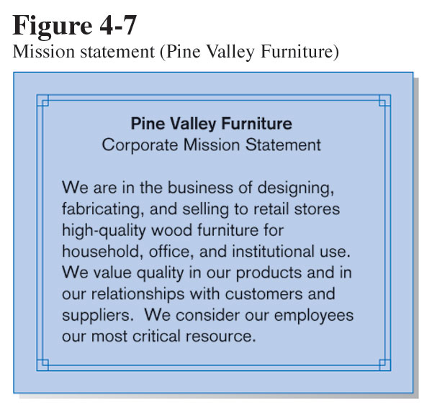
Pine valley Furniture

Slide 20
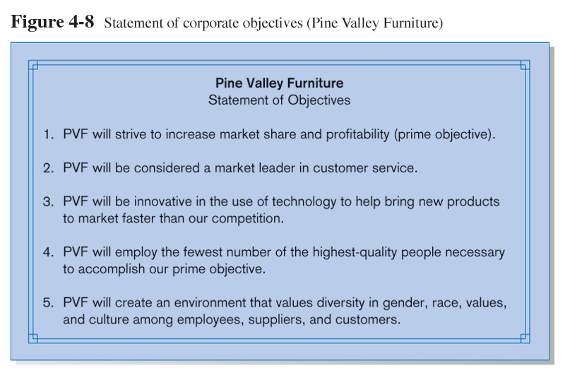
Statement of Objective

Slide 21
Corporate and Information Systems Planning
Corporate Strategic Planning
Competitive Strategy
The method by which an organization attempts to achieve its mission and objectives(such as lower cost producer, product differentiation, or product focus)
4.21

Slide 22
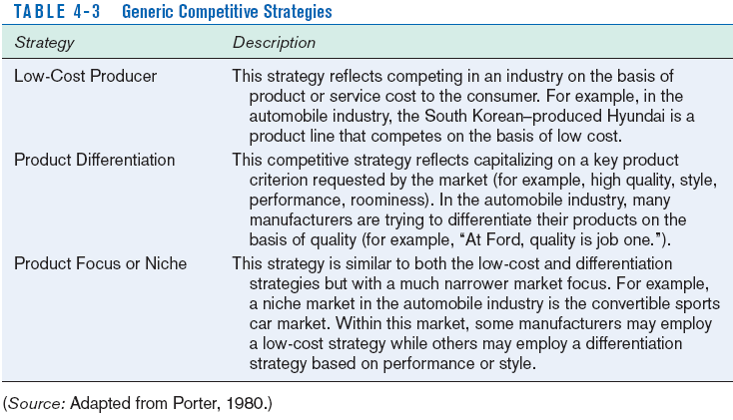
Corporate Strategic Planning

Slide 23
Corporate and Information Systems Planning
Information Systems Planning (ISP)
An orderly means of assessing the information needs of an organization and defining the systems, databases and technologies that will best satisfy those needs
Three key activities:
Describe the Current Situation
Describe the Target (or Future) Situation
Develop a Transition Plan and Strategy
4.23

Slide 24
Corporate and Information Systems Planning
Information Systems Planning
1. Describing the Current Situation
Top-down Planning
Generic methodology that attempts to gain a broad understanding of the information system needs of the entire organization, advantages of this approach are broader perspective, improved integration, improved management support, and better understanding.
Bottom-up Planning
Generic methodology that identifies and defines IS development projects based upon solving operational business problems or taking advantage of some business opportunities
4.24

Slide 25
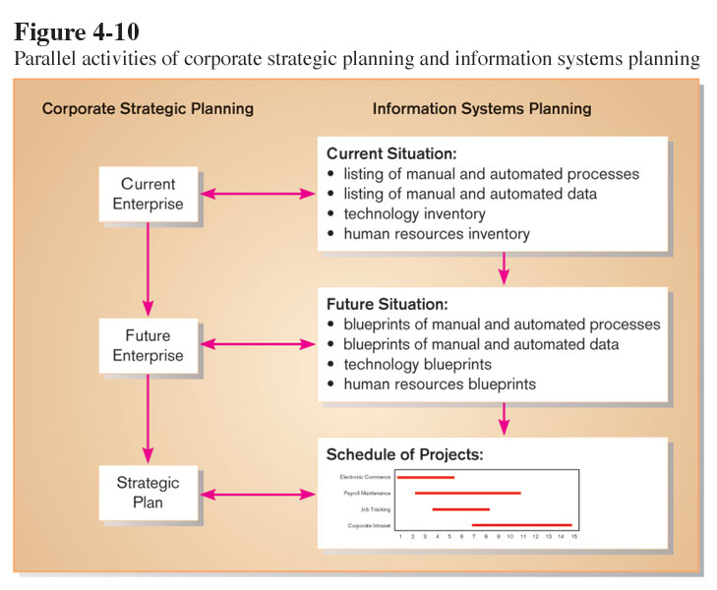
Information Systems Planning

Slide 26
Corporate and Information Systems Planning
Describing the Current Situation (Continued)
Planning team is chartered to model existing situation
Identification of Organizational:
Locations
Units
Functions
Processes
Data
Information Systems
4.26

Slide 27
Corporate and Information Systems Planning
Describing the Current Situation (Continued)
Matrices are developed to cross-reference units
Location-to-Function
Location-to-Unit
Unit-to-Function
Function-to-Objective
Function-to-Process
Function-to-Data Entity
Process-to-Data Entity
Process-to-Information System
Data Entity-to-Information System
Information System-to-Objective
4.27

Slide 28
Corporate and Information Systems Planning
2. Describing the Target Situation
Update list of organizational locations, functions, etc. to reflect desired locations, functions, etc.
Matrices are updated to reflect future states
Planners focus on differences between current lists and future lists and matrices
4.28

Slide 29
Corporate and Information Systems Planning
3. Developing a Transition Strategy and
Plans
Broad, comprehensive document that looks at both short and long-term organizational development needs
Consists of a series of projects
4.29

Slide 30
Electronic Commerce Applications
Development process for Internet projects is no different than other projects
Special issues need to be taken into account. such issues are (user, connection speed, and access method)
Electronic Commerce (EC)
Internet based communication designed to support business activities
4.30

Slide 31
Internet Development
Internet
Worldwide network of networks used for electronic commerce
Intranet
Internet-based communication to support business activities within a single organization
Extranet
Internet-based communication to support business-to-business activities
4.31

Slide 32
Internet Development
Electronic Data Interchange (EDI)
The use of telecommunications technologies to transfer business documents directly between organizations
Internet vs. Intranet/Extranet Apps
Intranet/Extranet – developer knows how application will be run and used
Internet – developer faces various unknowns such as where is the user located and who is that user, connection speed, and access method (browser, web enabled cellular phone or TV.)
4.32

